Slide 1

RFID Blocking
- Name: Meryem FARHAT
- Student ID: CA/JA3/3916
- Domain: Cyber Security
- Duration : 25th January 2025 to 25th April 2025

Slide 2

Table of contents
01
04
02
05
03
06
Introduction
examples
how rfid works
Demo
what is rfid blocking
Thank you slide

Slide 3
Introduction
🔹 What is RFID?
RFID (Radio Frequency Identification) is a wireless technology that uses electromagnetic fields to automatically identify and track tags attached to objects. These tags are found in items like credit cards, passports, and ID badges.
🔹 The Problem: RFID Attacks
As RFID technology becomes more widespread, it introduces new security risks. Many RFID-enabled cards (especially contactless payment cards) are vulnerable to unauthorized scanning, which can happen without physical contact or the owner's knowledge.
Common RFID Attacks:
Skimming: An attacker uses a hidden RFID reader to scan data from cards in your pocket or bag.
Eavesdropping: Intercepting the communication between the RFID tag and reader.
Cloning: Copying the data from one RFID card to another to gain unauthorized access.
Tracking: Using RFID tags to monitor someone's movements or behavior without consent.
These attacks are silent, fast, and can result in identity theft, financial fraud, or privacy violations.

Slide 4

How RFID Works
🔸 Main Components of an RFID System
RFID Tag:
A small chip with an antenna that stores data and responds to nearby readers.
RFID Reader:
Sends radio waves to detect and read data from tags.
Backend System:
Processes and stores data received from the reader.
🔸 How RFID Communication Works
The reader sends a radio signal.
A nearby tag picks up the signal and responds with its data.
The reader collects the data and sends it to the system for processing.
🔐 It's fast and contactless, but this also makes it vulnerable to unauthorized scans.

Slide 5
🔸 What is RFID Blocking?
RFID blocking is a method used to prevent unauthorized access to data stored on RFID-enabled items like credit cards and passports.
It works by blocking electromagnetic signals, stopping RFID readers from communicating with the tag.
How?
Most RFID blockers use Faraday cage materials—metallic layers that create a shield, absorbing or deflecting signals.

Slide 6
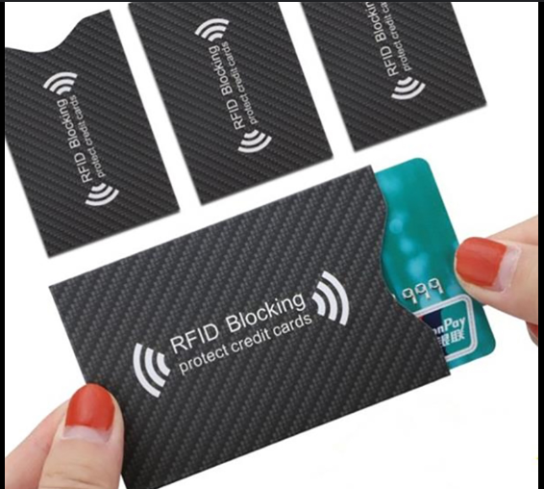
Examples of RFID Blocking Tools
RFID-blocking wallets and card sleeves
Passport covers with built-in shielding
Employee badge holders with protection
DIY solutions using aluminum foil

Slide 7


demo

Slide 8
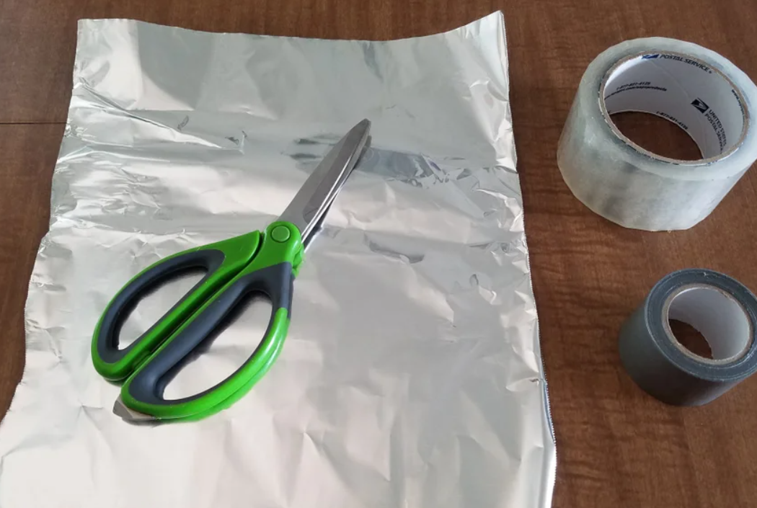
Step 1: Gather Materials
All we need are four items:
Aluminum foil (for signal blocking)
Duct tape (for structure)
Clear packing tape (to protect the foil)
Scissors (for cutting)

Slide 9
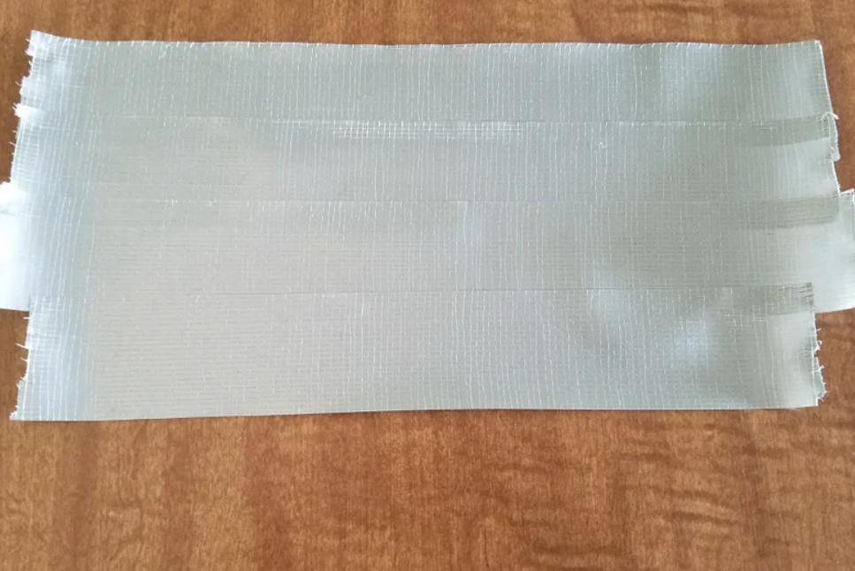
Step 2: Create the Base with Duct Tape
Lay overlapping strips of duct tape to form a sheet.
Make it slightly larger than the final pouch size.

Slide 10
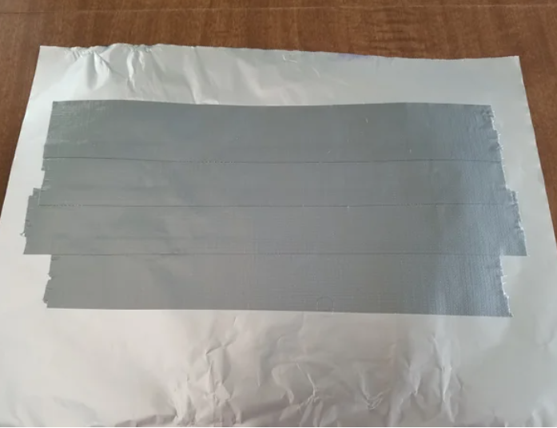

Step 3: Add Aluminum Foil Layer
we carefully place aluminum foil over the duct tape.
we tried to keep it as flat and smooth as possible for best shielding.

Slide 11
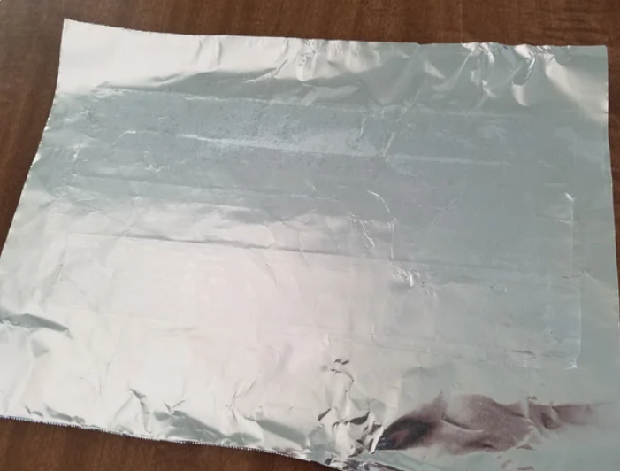
Step 4: Seal with Packing Tape
we cover the aluminum foil with clear packing tape.
This prevents damage and protects card chips from direct contact with foil.

Slide 12
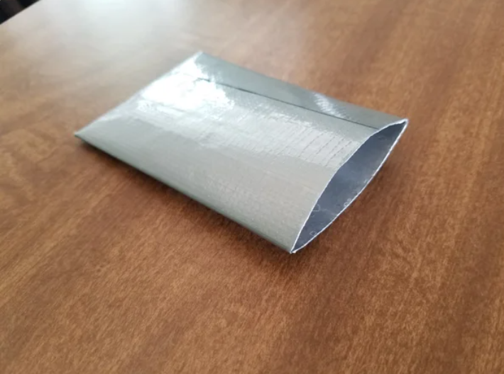
Step 5: Cut to Desired Size
we trim the sheet to a rectangle slightly larger than a credit card.
Fold it in half to form the pouch shape.

Slide 13
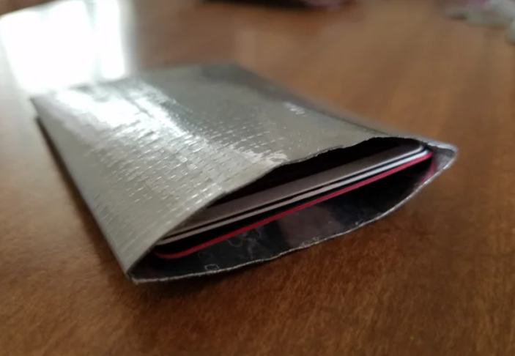
Step 7: RFID-Blocking Pouch Completed!
Insert the card and test it near an RFID reader. (i don’t have rfid reader so i couldn’t test it)
It should block the signal completely, protecting your data!

Slide 14
Thank you
.

